Slide 1
BUSINESS CASE
SYH: How can SYH improve or expand its network to better serve younger travellers (U27)
Reimagining budget friendly and sustainable Accomadation for GEN Z

Slide 2
THE BIG ISSUE
Only 10-20% of SYH’s customer base is GenZ
Why is this an issue? GenZ is their main target

Slide 3
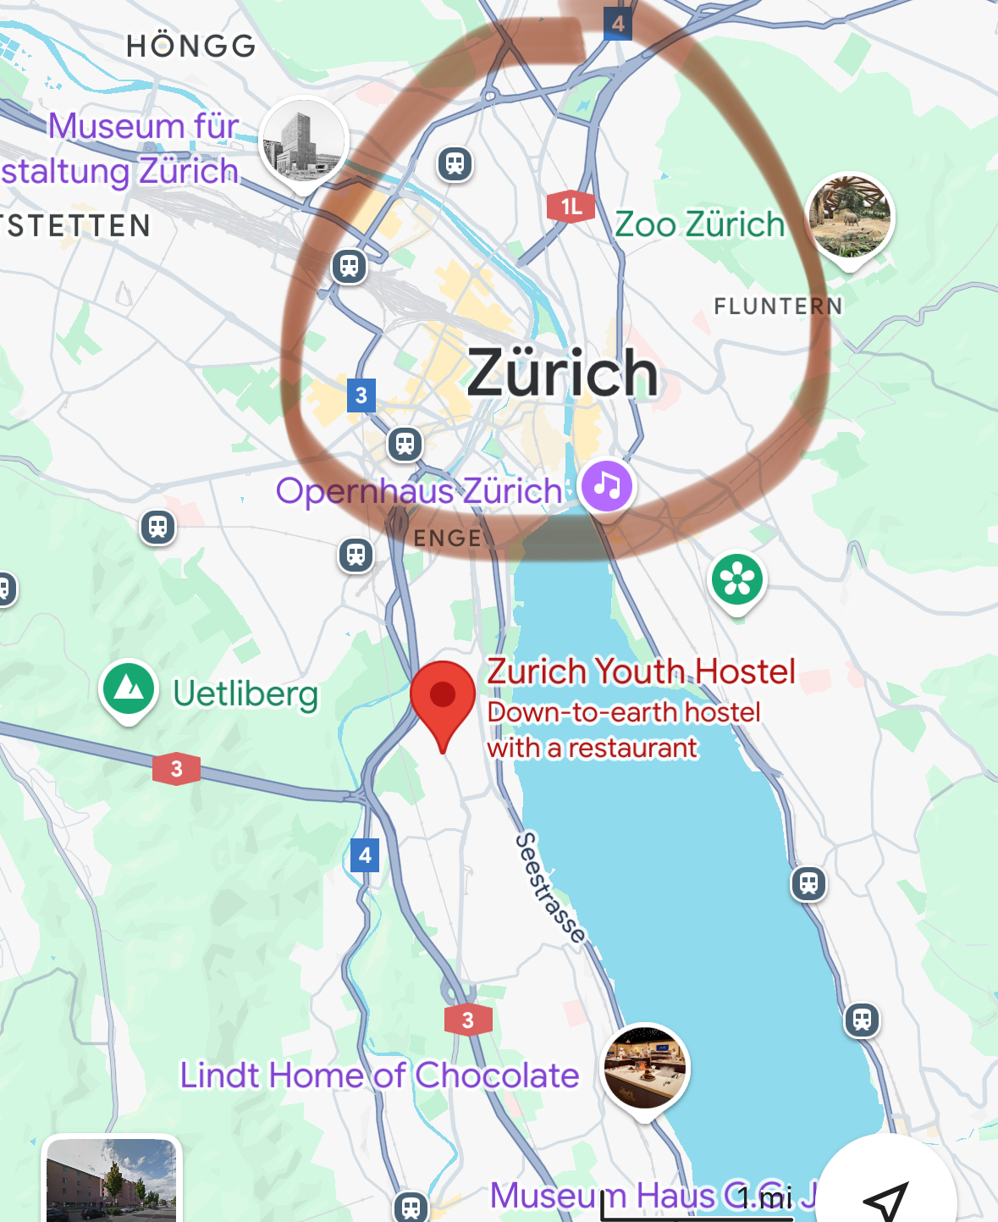
Context of SYH: key takeaways
Advantages
Weaknesses
Affordability💸
Sustainability 🍃
Flexibility 🛏️
Location variety (40 + locations throughout Switzerland)📍
We will address the weaknesses in a budget friendly way
Marketing📱📸🤳
Location (e.g. the hostel in Zurich isn't even in Zurich📍

Slide 4
COMPETITORS ANALYSIS (Switzerland)
Aspect | SYH | Meininger Hostels (main hostel competitor) | Camping | Airbnb | Hotel
Price | 35-60 CHF (low) | 45 - 75 CHF (medium relatively) | low | Medium | high
Quality | Low-medium | Medium | Low | depends | Very high
Customer Service | okay | okay | none | okay | Very good
Location | 40+ | 2 (Zurich and Geneva) | 344 camp sites | 50K+ listings | 4K +

Slide 5
BUSINESS PLAN
BUDGET: 1.5M (profits), already currently investing 1.4M in marketing

Slide 6
1. Marketing

Slide 7
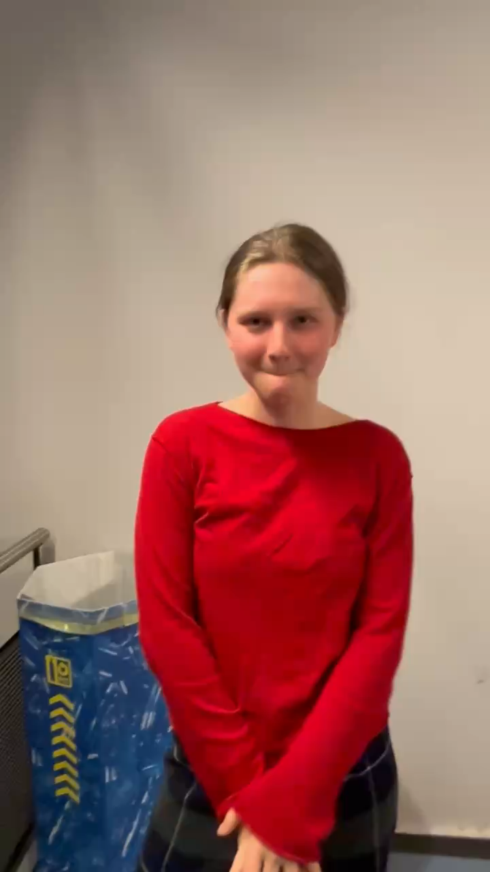
TARGET TRAVELER PROFILE
VALUES – affordability, sustainability, flexbility, local authenticity, being social
HABITS – social media (specifically Instagram, Tiktok, Youtube), group travelling and even solo
PREFERENCES – fast wifi, activities, nice views, community activities

Slide 8
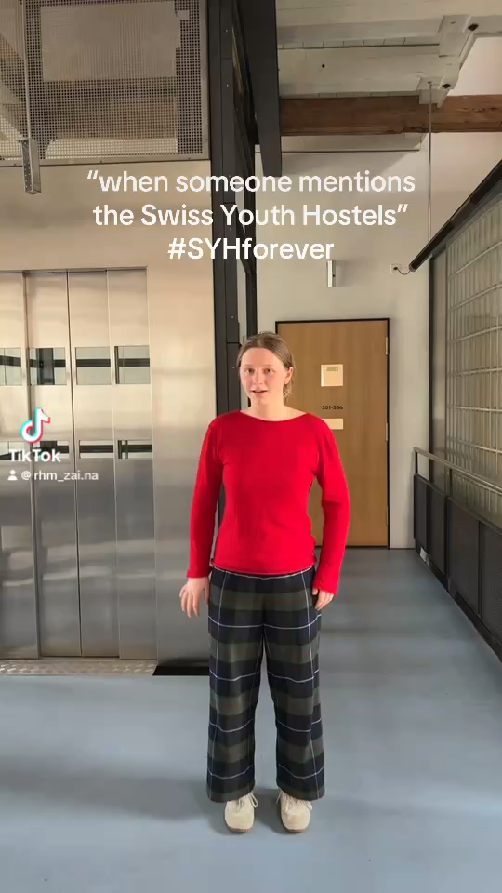
IMPLEMENTATION 1: AMPLIFIED DIGITAL PRESENCE
1. Redirect the current hired social media manager’s efforts towards creating a Tiktok for advertising – specifically keep up with on-going trends

Slide 9
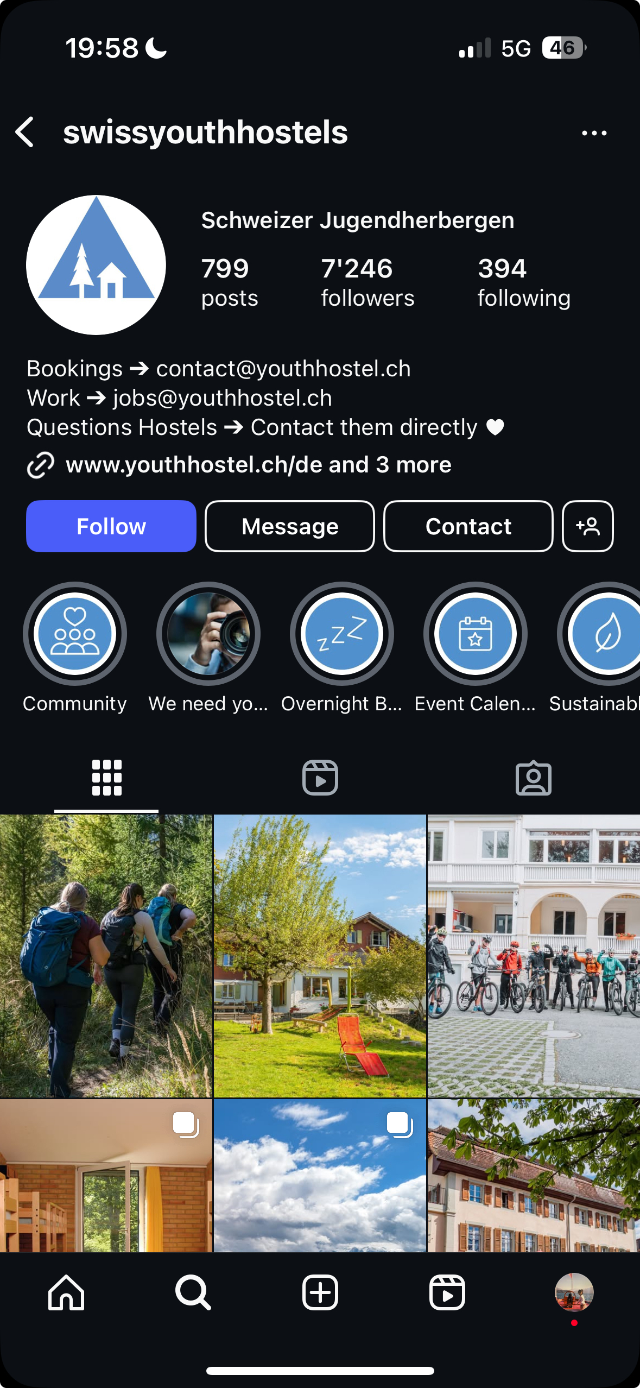

IMPLEMENTATION 1: AMPLIFIED DIGITAL PRESENCE
SYH does have an Instagram plaform BUT content that is posted there isn’t tailored to genZ
Content is tailored for the wrong target audience ( features old people and not younger content creators)

Slide 10
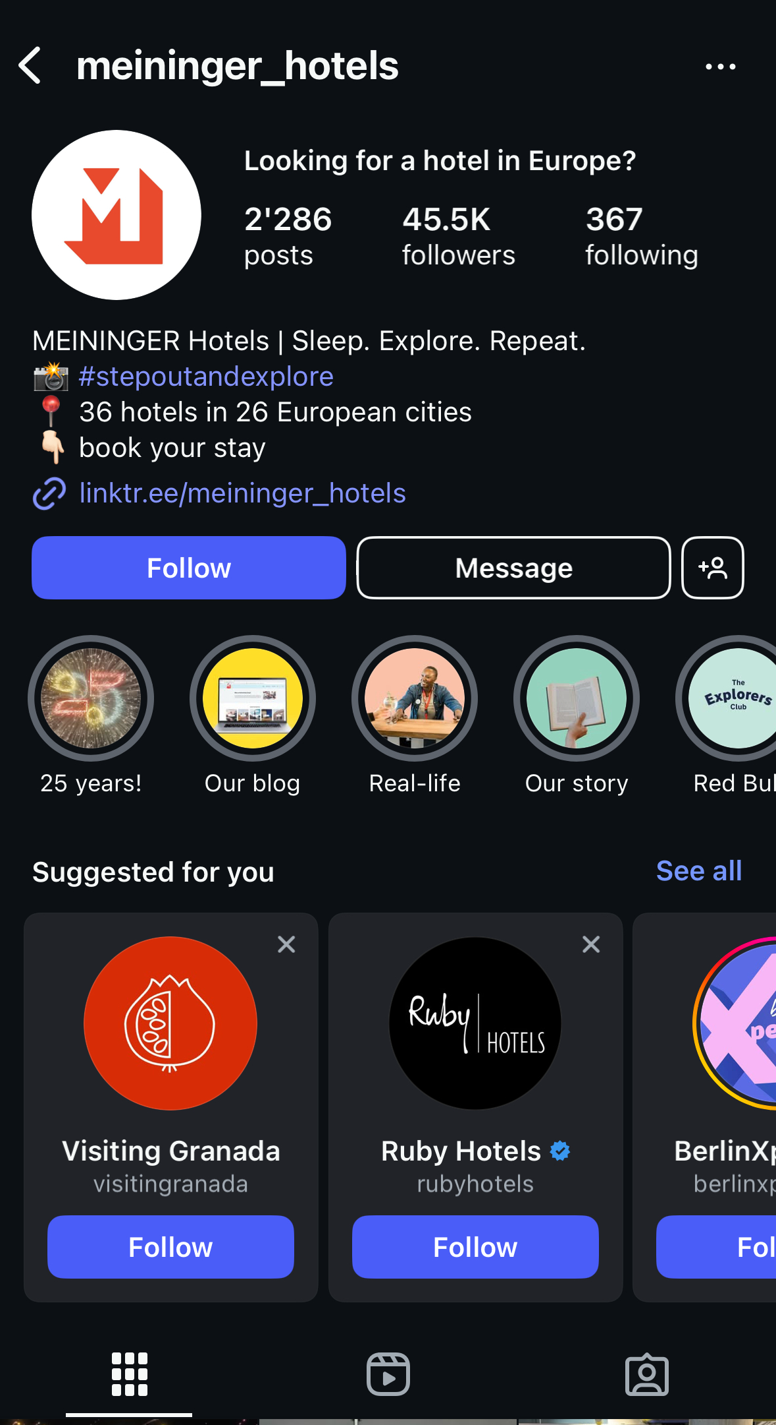
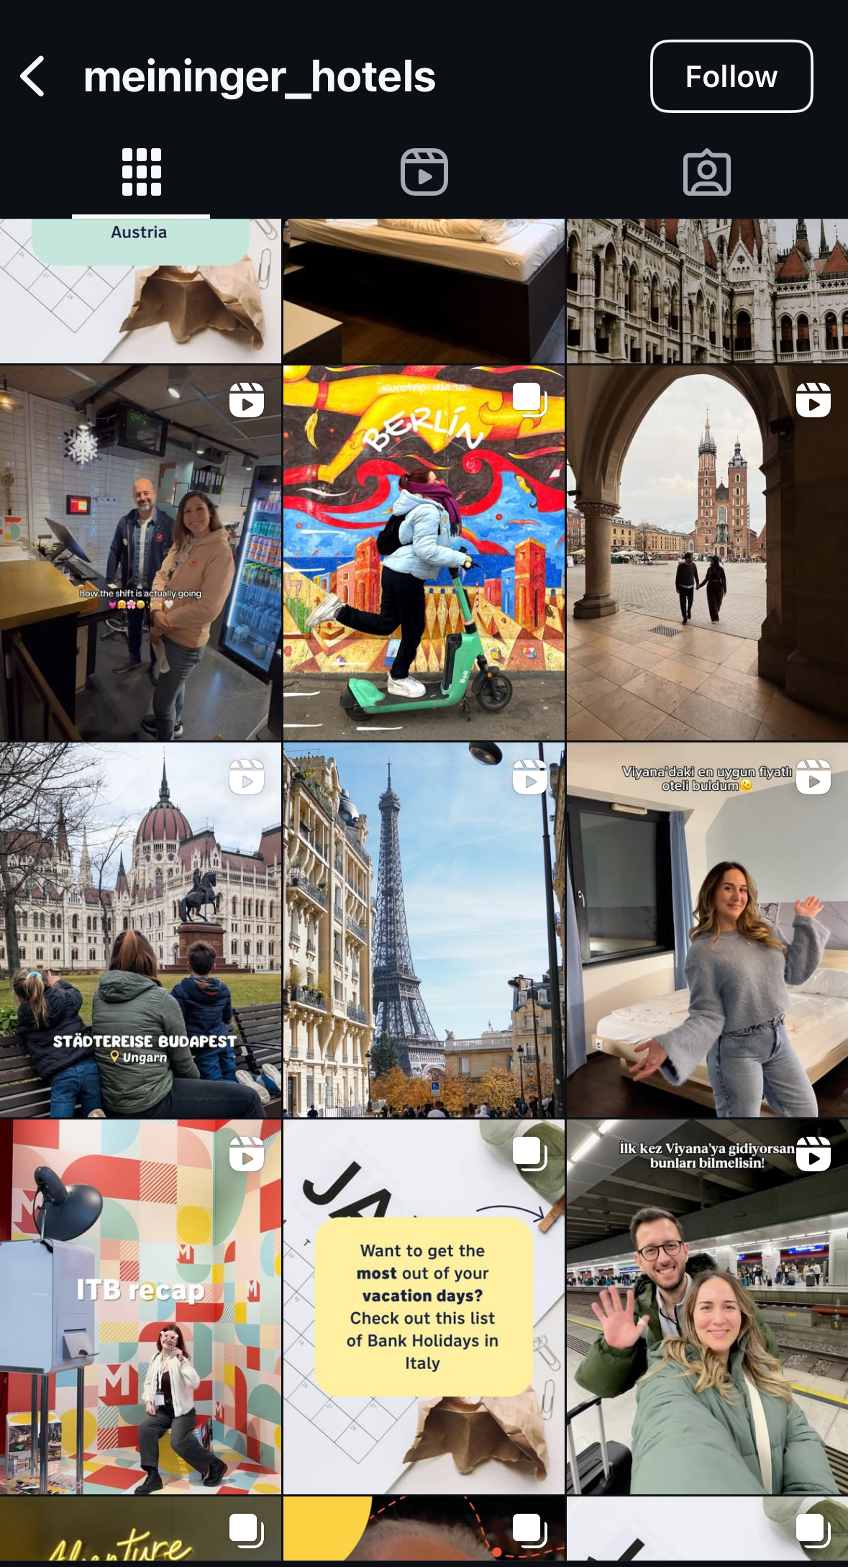
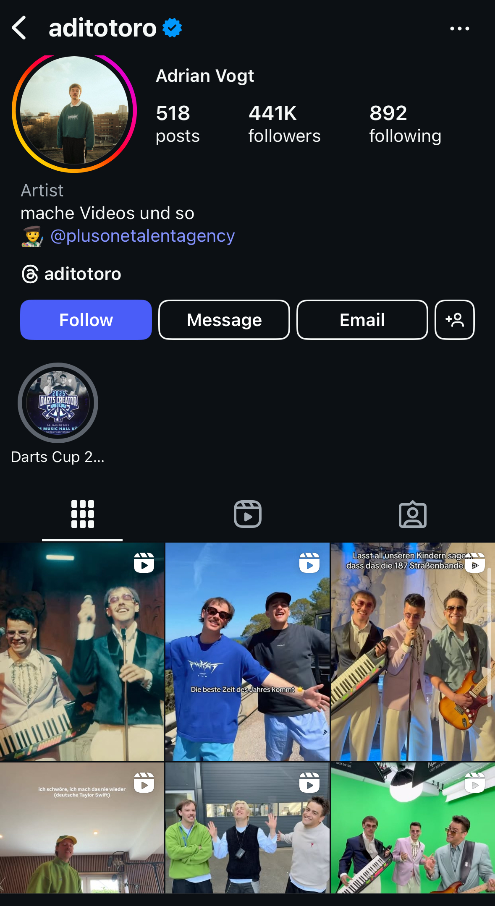



EXAMPLE OF KEEPING UP WITH TRENDS
Partner with small swiss content creators that expand the outreach – offer free nights to the content creators in exchange for high quality content and a positive review on their platforms
BALANCE: invest 1/3th of the 1.4M of the current marketing budget into making the social media platforms better and the 2/3th on partnerships with established content creators (Aditotoro)
Green colour scheme appeals to the ecofriendly brand image
Notes:
Do mention that they have hotels across europe, but we want to make the point clear that syh content currently isnt good enough for the target audience bc its featzuring like old ppl

Slide 11
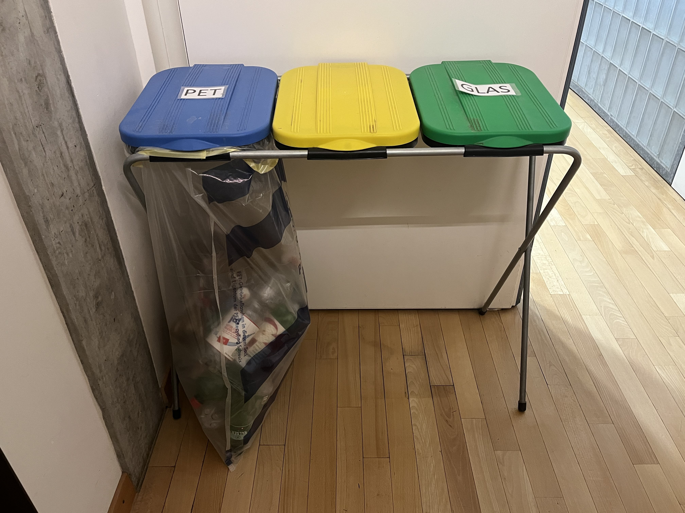
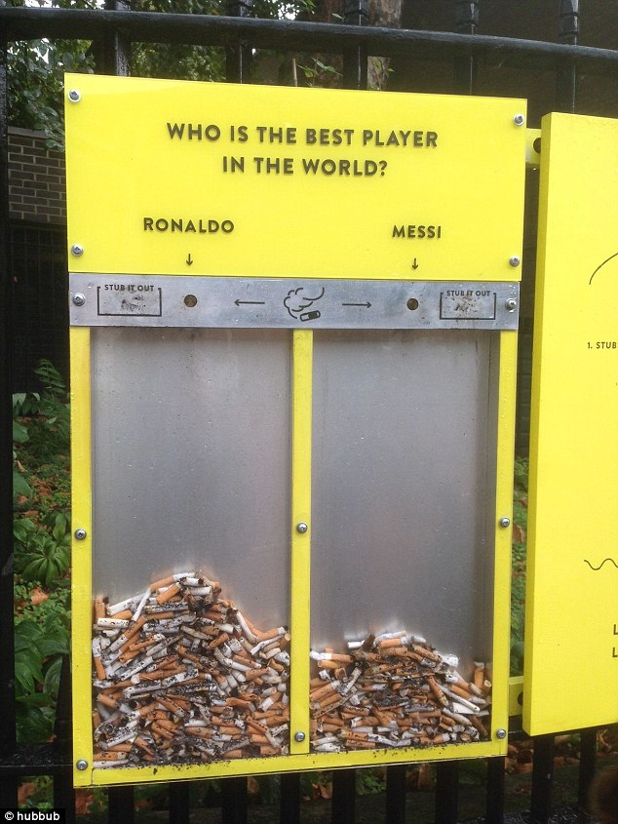
IMPLEMENTATION 1.1: BUILING THE BRAND IMAGE
Nudges can be a great way to again promote the eco-friendly brand image by having such initiatives
After
Before

Slide 12
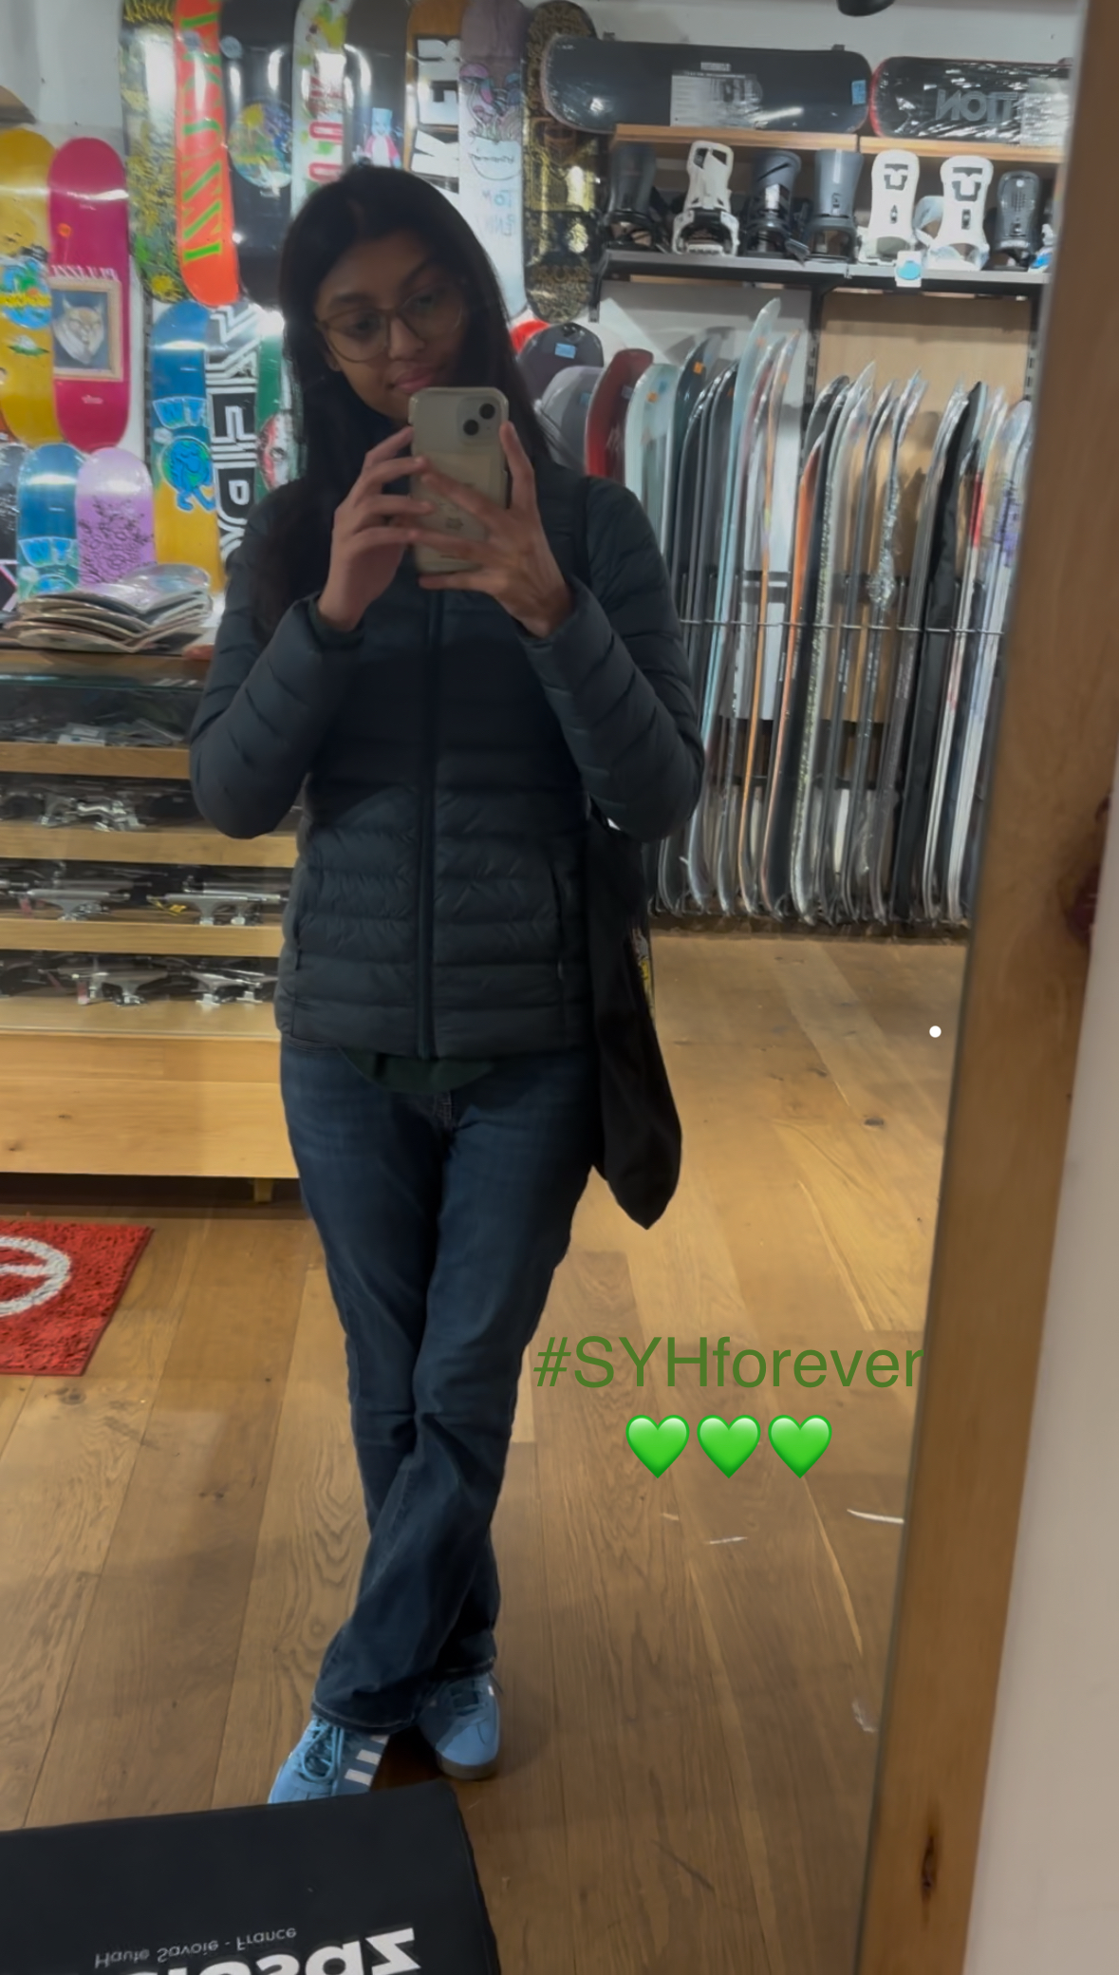
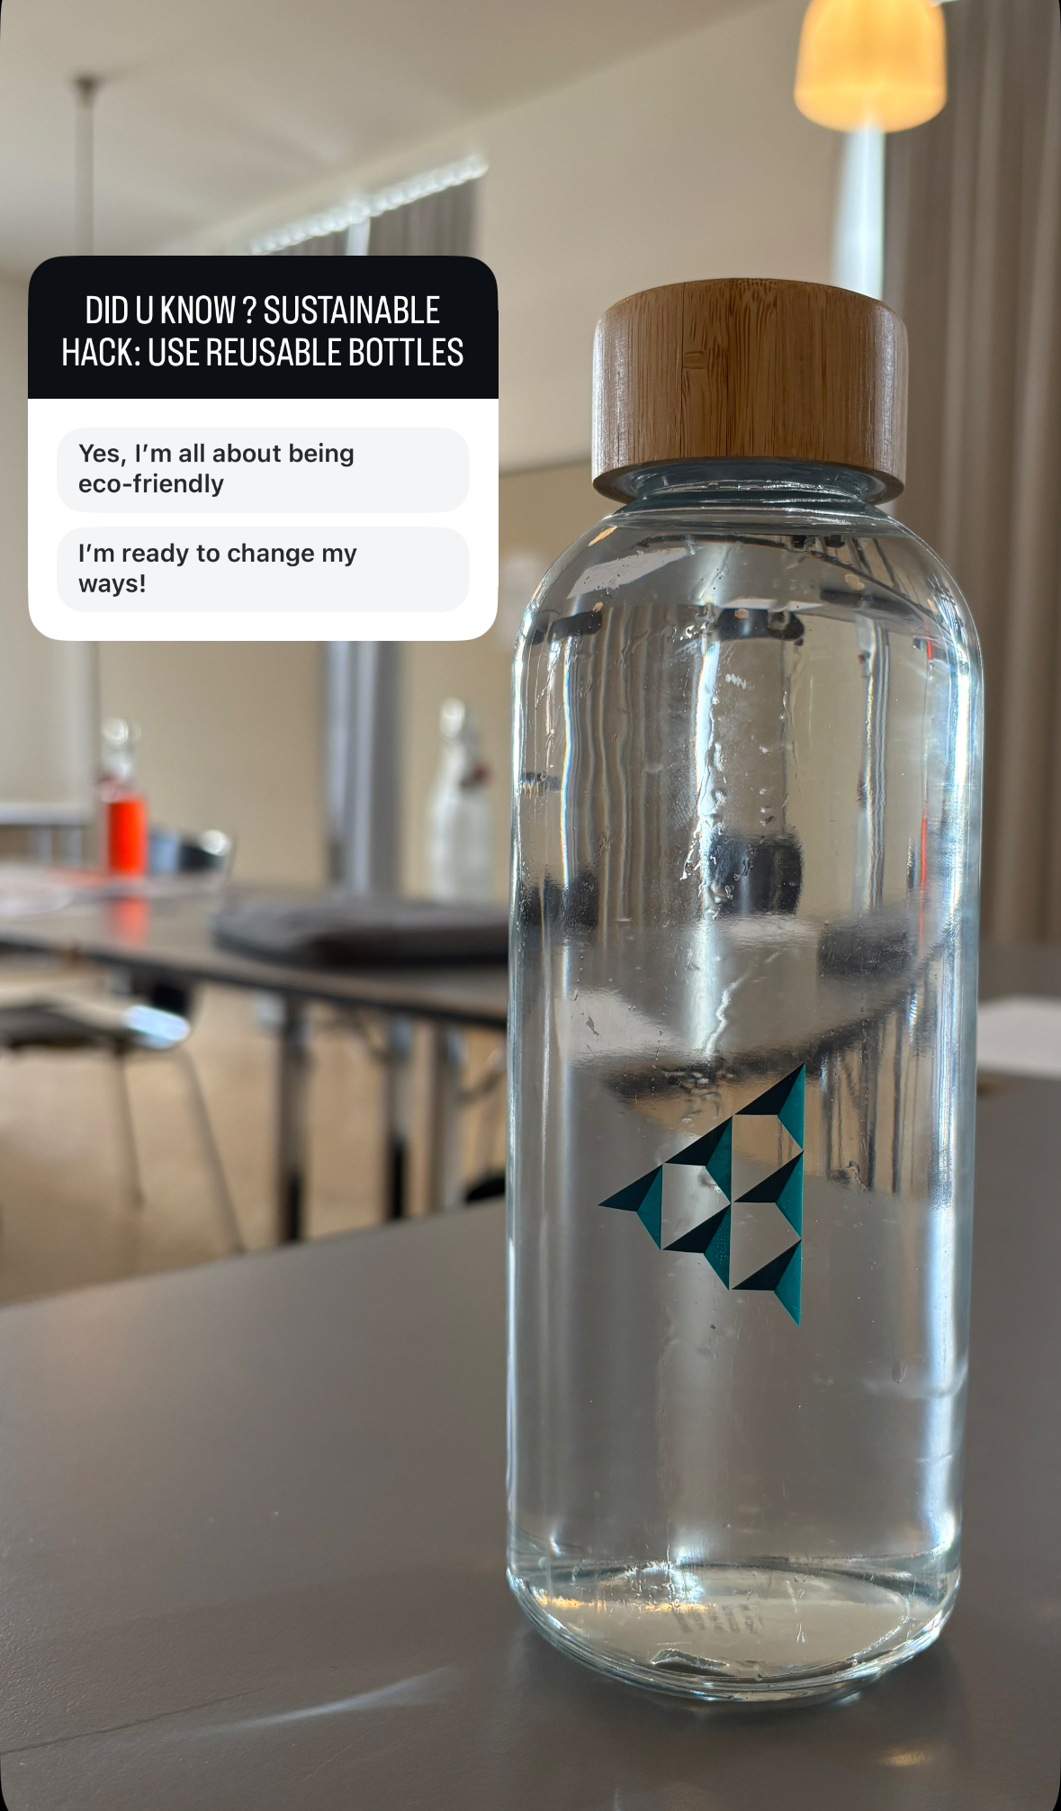
IMPLEMENTATION 1.1: BUILING THE BRAND IMAGE
Interactive posts: launch digial challenges and fun tips like “sustainable travel hack of the week”
Quick wins: Put around mirrors for people to take selfies in and put a hashtag eg. #SYH for people to tag on Instagram (=gain visibility )

Slide 13
Importance of branding - location wise
According to SYH data, the most common locations for young travellors included places like Zurich, Basel, Lausanne
We fully support the idea of expanding into regions such as Geneva to attract youth as it is quite known for its tourism (2nd in Switzerland after Zurich)
And as already established, SYH has lower prices, so the main aim will be to tackle selling the brand as better and more reputable than Meininger (=brand image) which have the leverage in that location

Slide 14
2. The experience

Slide 15
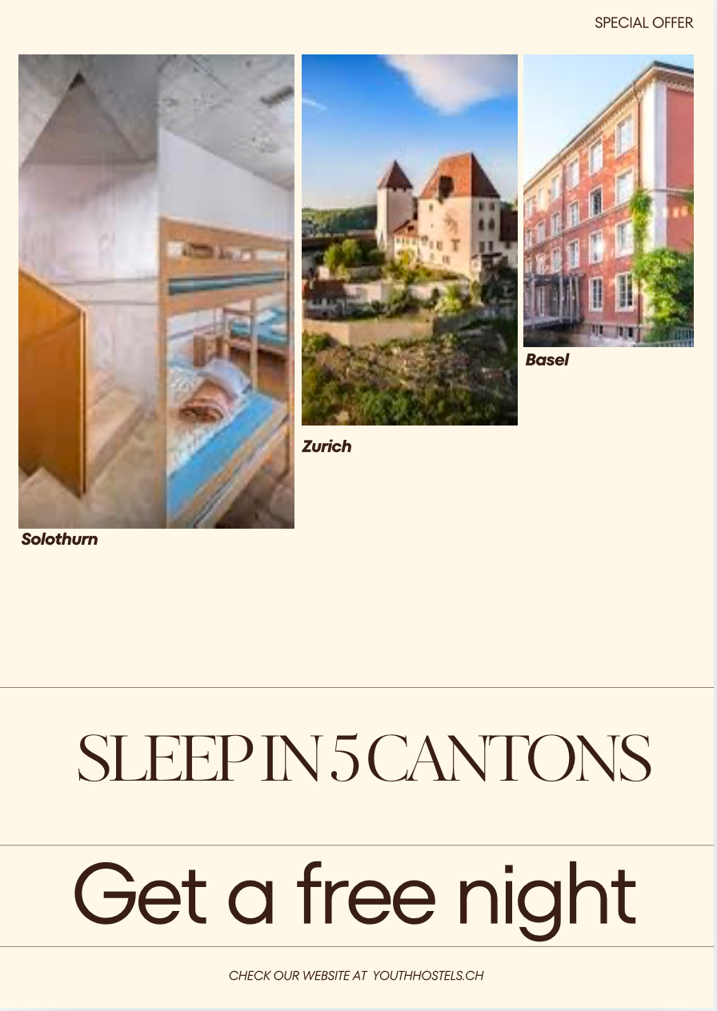
IMPLEMENTATION 2: Gamify the experience at the youth hostel
Introduce perks such as “Sleep in 5 different cantons, Earn a Free night”= could give incentive to young travellors to complete the challenge and in turn return to SYH more often.
For the free night, to keep it profitable, we can give it to the members of the association specifically or maybe to hostels with free beds available (less popular location) or during off-peak season (when occupation rates are lower)

Slide 16
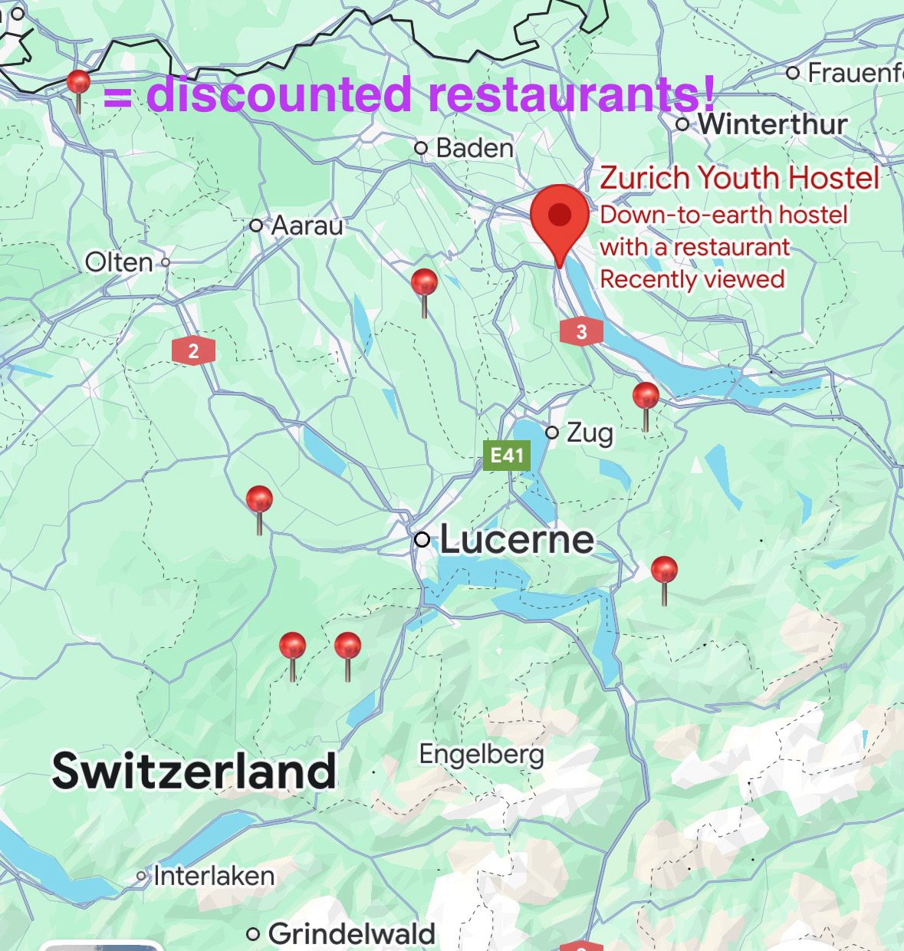

IMPLEMENTATION 2.1: EVENTS
Introduce game nights and with the current available games such as mini football
Interactive activities that support the sustainable brand image
E.g person with the best TikTok promoting the message of sustainability gets a free dinner at the hostel
Communicated through the content creators or even possibly through the mobile app
Communicate available discounted restaurants

Slide 17
IMPLEMENTATION 2.3: Hostels with the most success – feature wise
Cozy communal room areas can attract many young people to socialise
Due to budget constraints rooms could be repurposed through changes in furniture (= no need for complete rennovation)
How to achieve this? Music playing in the background to create a vibe, include cosy couches that are movable
Occasionally utilise the conference rooms as relaxation places

Slide 18
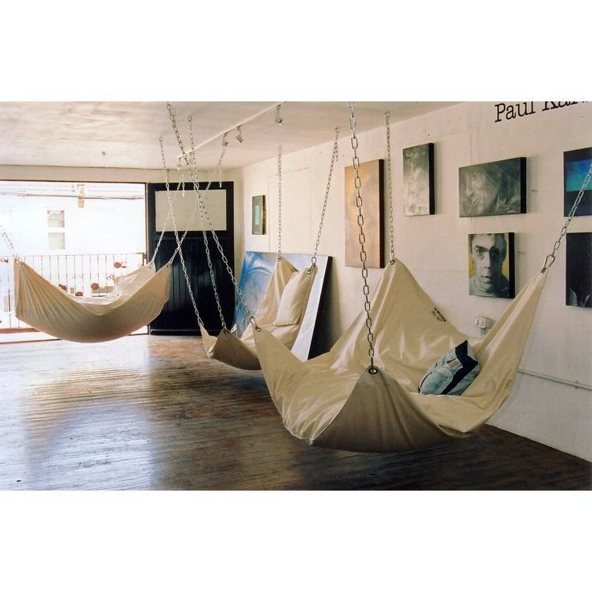
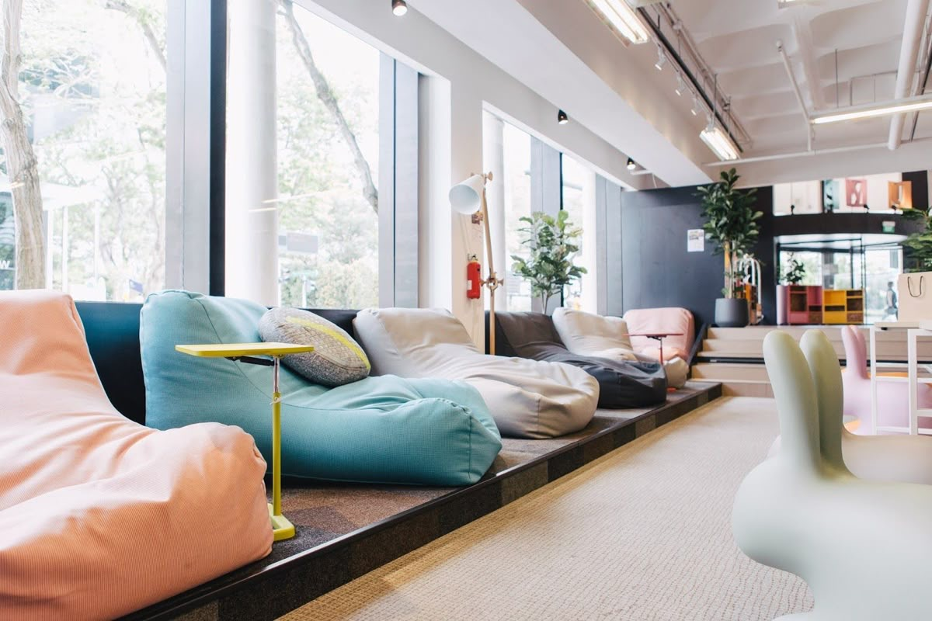
IMPLEMENTATION 4: Hostels with the most success – feature wise

Slide 19
Conclusion
Main priority should be to improve presence on social media and make the experience at the hostel one that is worth coming back to.
With this strategy we are confident to raise the percentage significantly of returning customers and the percentage of youth to SYH.
🥳🥳🥳🥳

